Slide 1
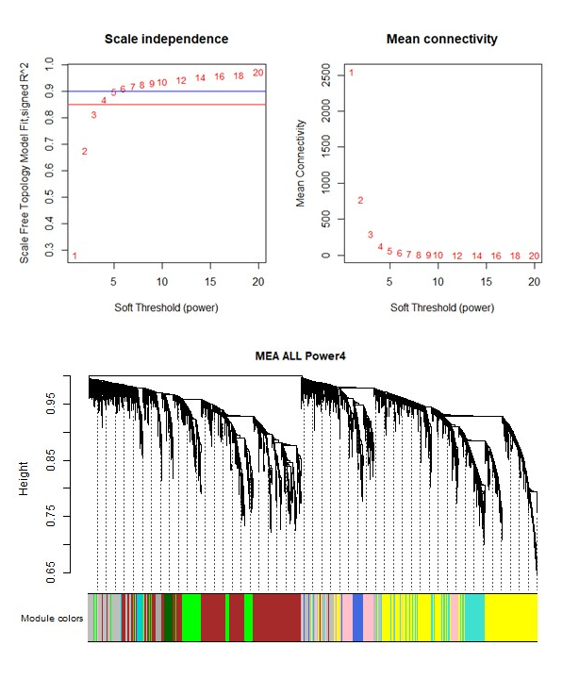
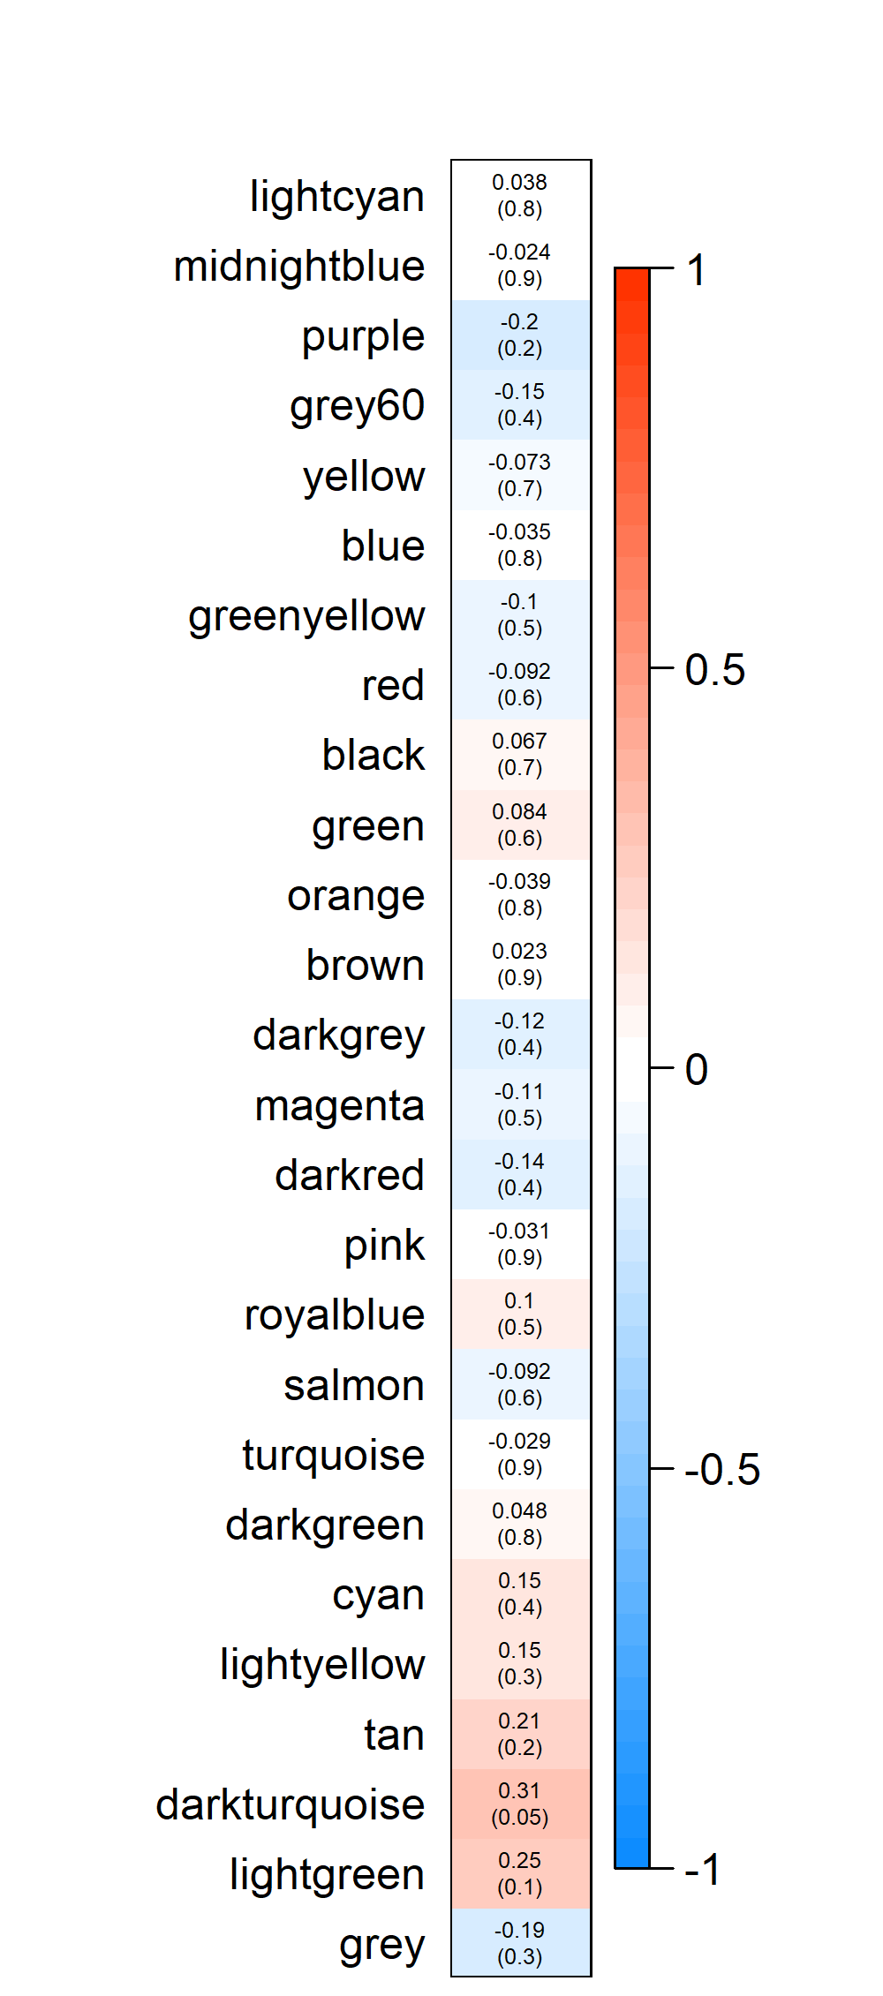
I)
III)
Module–Trait Relationship
II)
Social Condition

Slide 2
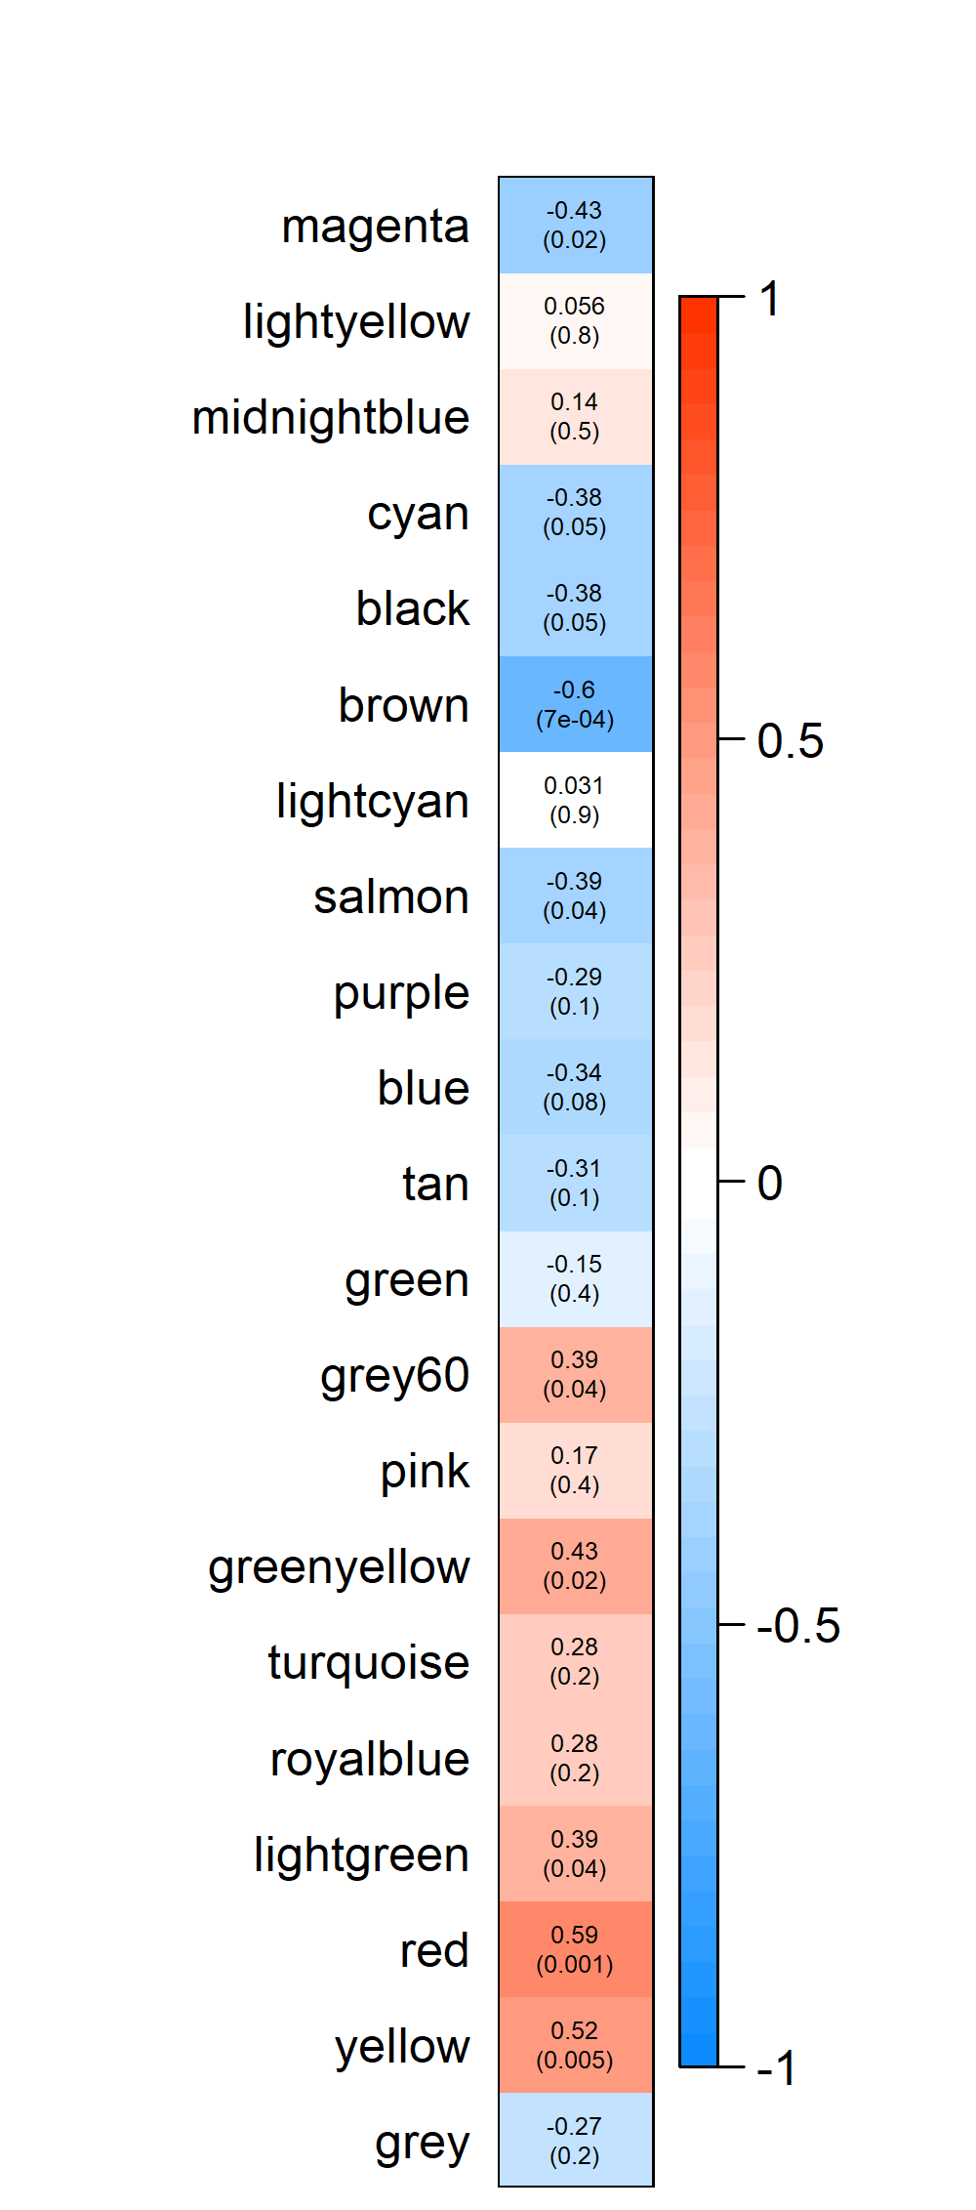
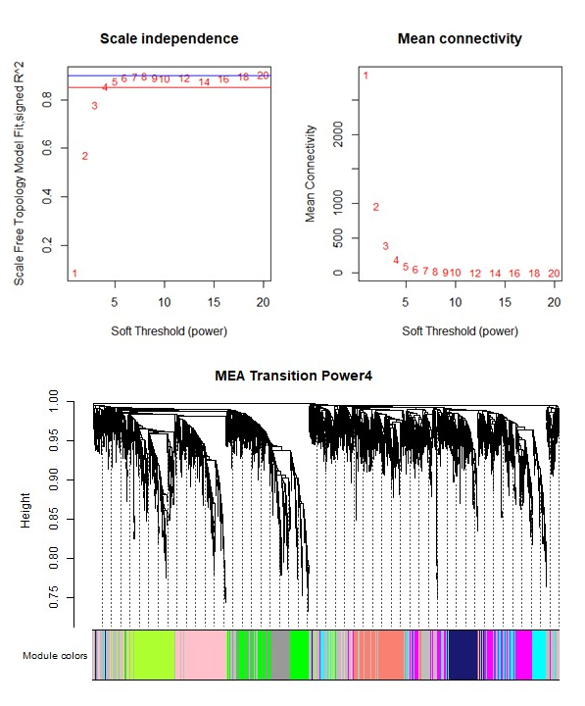
I)
III)
Module–Trait Relationship
II)
Social Condition

